Slide 1


DATA BREACH or DATA SCRAPE ?
the LinkedIn 2021 Data Leak
CTEC-114 Fall 2022
Jeffrey S. Walley

Slide 2

What company was involved?
Linkedin was the company involved in the data breach.

Slide 3

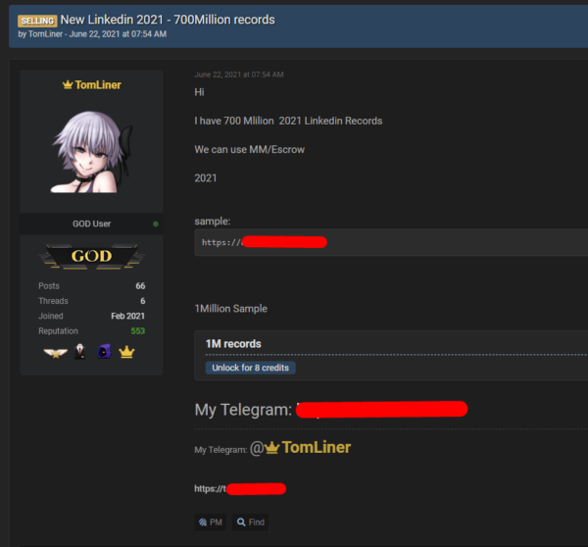
Who perpetrated the breach?
A user known as ‘TomLiner’, using the moniker ‘GOD user’ perpetrated the information gathering.

Slide 4

What exactly happened?
LinkedIn’s API (Application Programming Interface) was misused by a third party to gain access to the personal data of millions of users.

Slide 5

When Did the breach occur?
June 2021
This Photo by Unknown Author is licensed under CC BY-NC

Slide 6

Where did the data turn up?
Information was dumped to a Dark Web forum site.
This Photo by Unknown Author is licensed under CC BY-SA

Slide 7
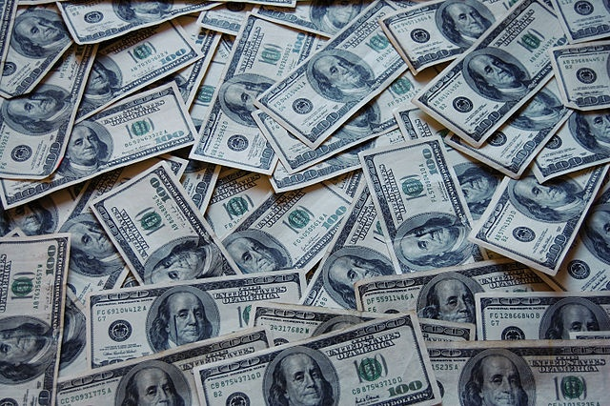
Why did the breach occur?
The user data was available for auction.
This Photo by Unknown Author is licensed under CC BY

Slide 8

How many users were affected?
Over 7 million users had personal data ‘scraped’ and put into a database.
This Photo by Unknown Author is licensed under CC BY-NC-ND

